Slide 1
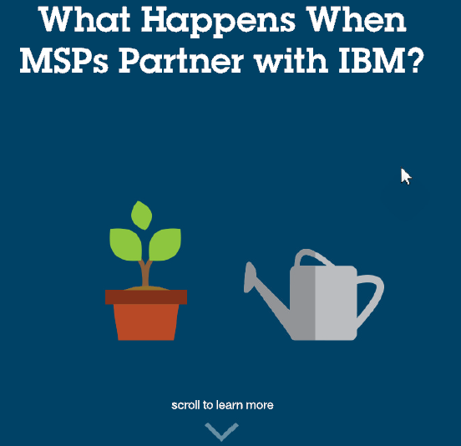
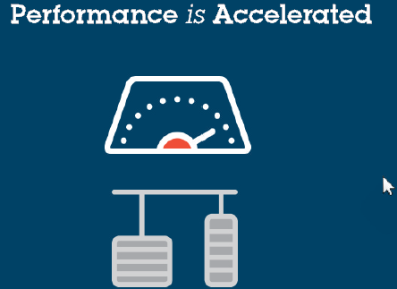




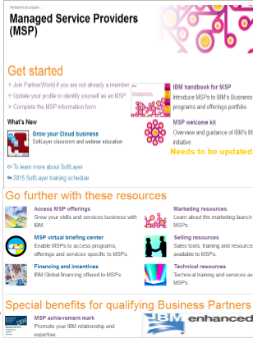
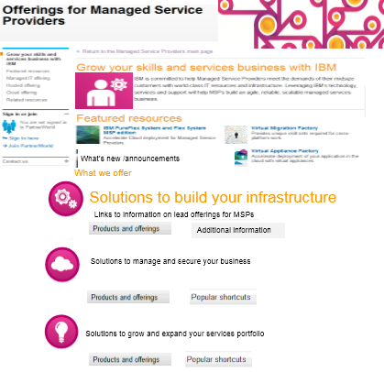
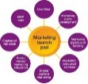

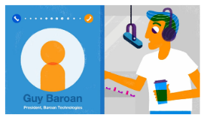
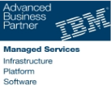



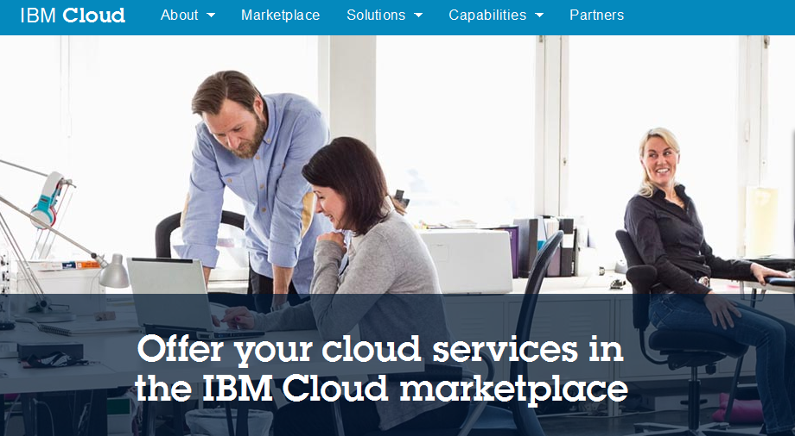
Campaign Map
MSP S/L landing page
Interactive
Infographic
More information on the MSP Program
Registrations / Chat - NA MSP LDRs
(OI)
Chat now function
More information on the MSP offerings
http://pivotpoint.io/msp-with-ibm
Paid Search
AdWords
MSP PartnerWorld
More information on the MSP Program
MSP Lead form submitted
Organic Social
Link from MSP PW to the MSP portal to access the MSP the guide
Forms go to MSP Leaders by IMT for followup

Slide 2
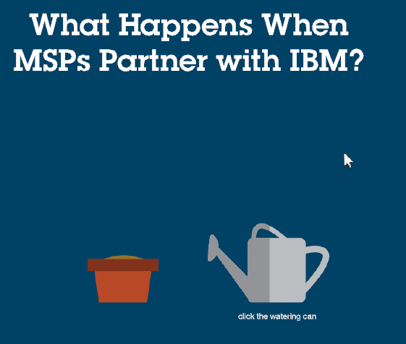
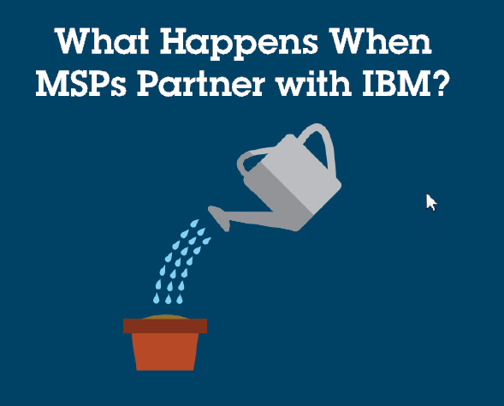
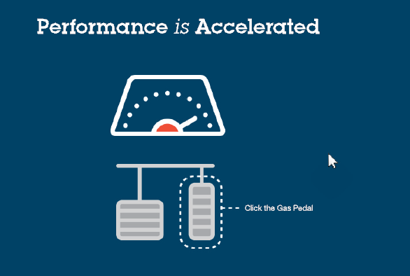
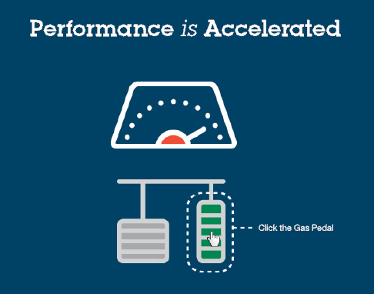
Partnering IBM Interactive Infographic
Performance Accelerated
Limitations are lifted
Services become smarter
Better marketing equals more clients
New doors are opened
Financing become flexible
http://pivotpoint.io/msp-with-ibm

